Slide 1

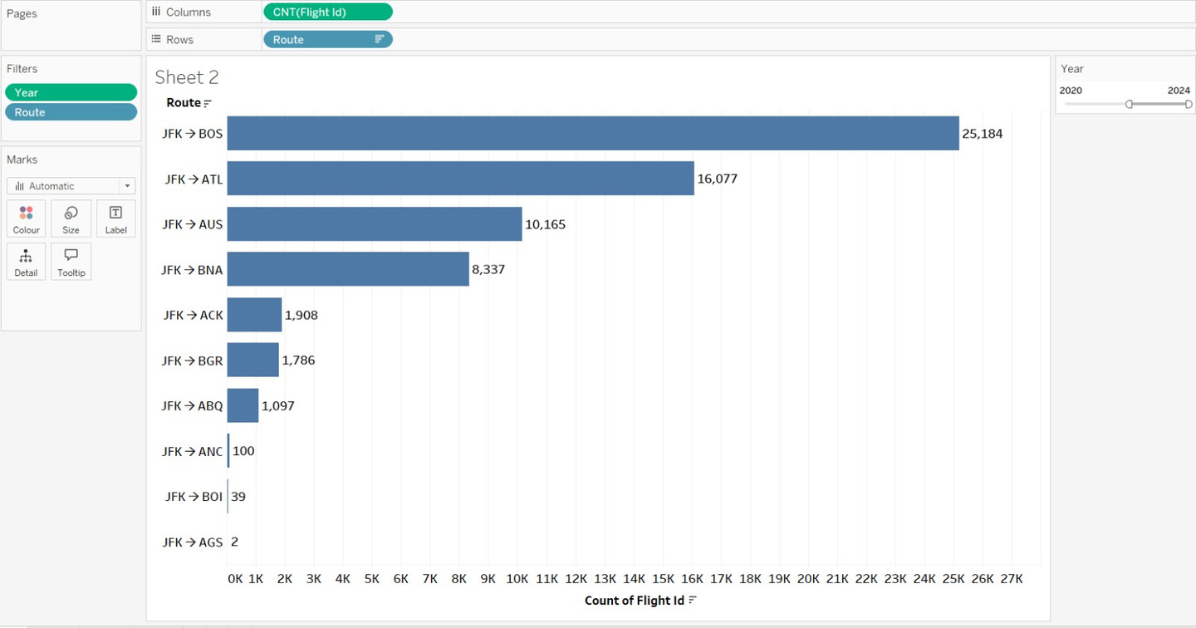
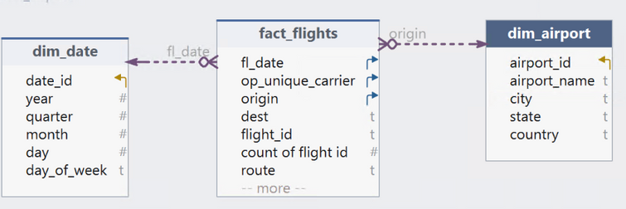


BUSINESS QUESTION 2
Which domestic routes from JFK recorded the highest number of flights between 2020 and 2024 ?
JFK’s busiest domestic routes (2020–2024) are JFK- BOS (25K flights) and JFK- ATL (16K), followed by JFK- AUS and JFK-BNA at a distant third and fourth.
Traffic is heavily concentrated in a few trunk routes, while destinations like ACK, BGR, ABQ, ANC, BOI, AGS account for only a tiny share of flights.

